Slide 1
Efficiency of Public Expenditure on Education—OECD Countries
ETM540-Group Project
Andey Nunes
Aparna raghuram
Jordan Hilton
Mohamed Sheikh
Samira Akhter

Slide 2
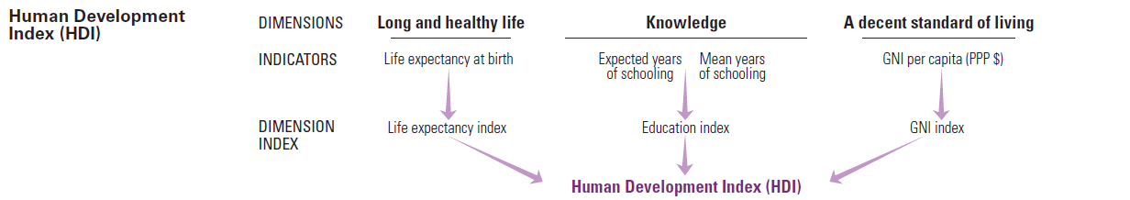
Background
Education is considered the backbone of any developed society and it’s a vital component of all in calculating the HDI

Slide 3
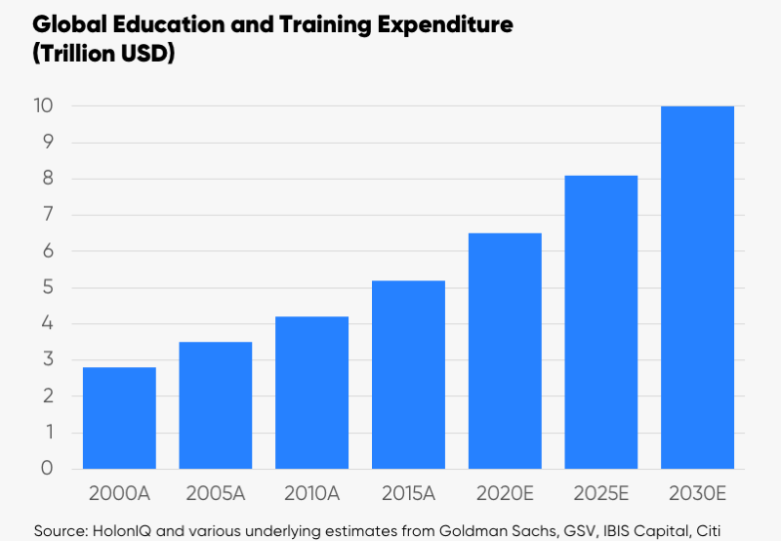
Current and projected Global Spending on education
Notes:
https://www.holoniq.com/2030/
http://www.holoniq.com/wp-content/uploads/2018/06/HolonIQ-Education-in-2030.pdf

Slide 4
Global Industry Needs
Standards for Measuring performance
Reliable data collecting agencies.
Benchmarking relative efficiencies in spending

Slide 5
PISA
Programme for International Student Assessment
Measures 15 year old on performance in Science, Math and Reading.
Every 3 years
PISA has been performing these assessments since 2000 and published data is available to all countries.

Slide 6
Project Scope
Use the latest available PISA data (2015) to benchmark educational efficiencies of OECD countries.
Extend efficiencies to determine how best to distribute additional money to improve overall performance.
Technique Utilized for this project
DEA
Linear Programming with sensitivity Analysis

Slide 7
Our Variables
Single Output:
Average PISA performance scores (Science, Reading and Mathematics.
Total Spending per student in dollars.
Multiple Output:
Total Spending per student in dollars.
Science, Reading and Mathematics

Slide 8
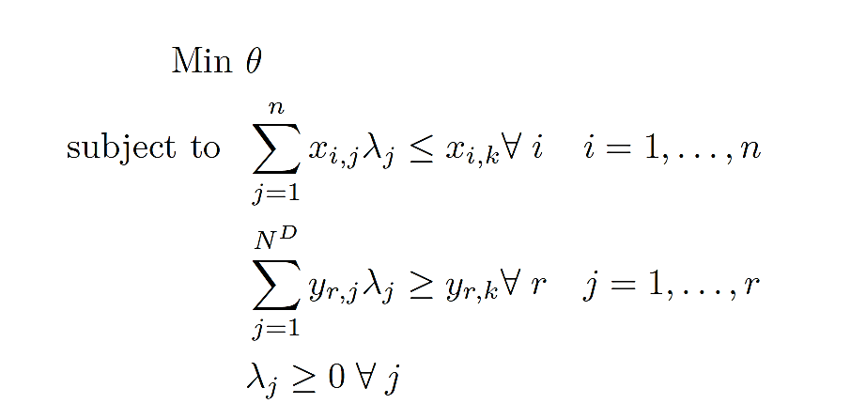
DEA Analysis
Output Oriented model.
Variable returns to scale

Slide 9
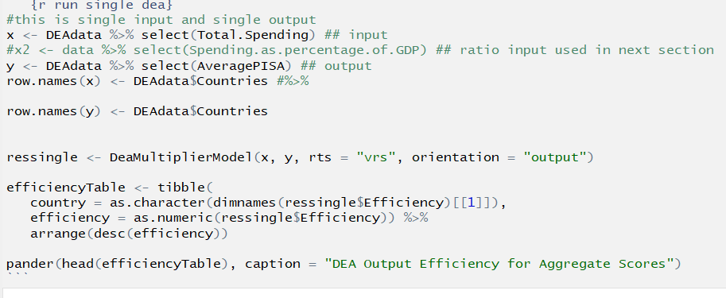
Implementation of the Model

Slide 10
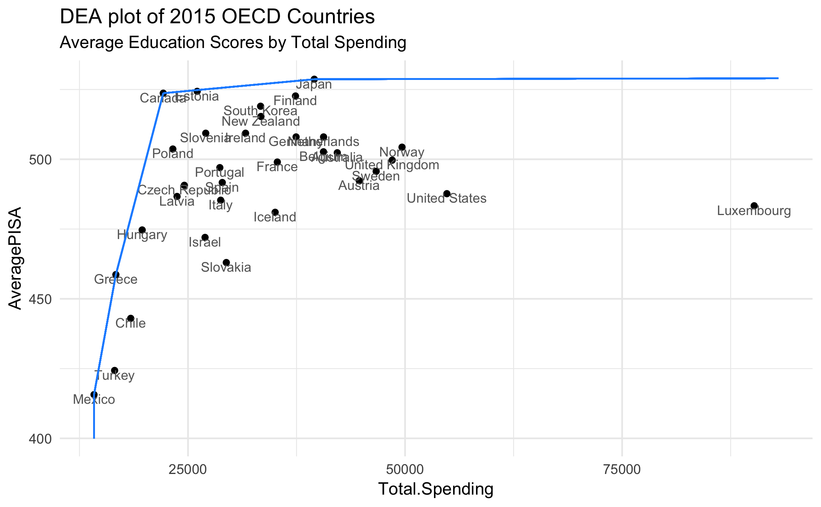
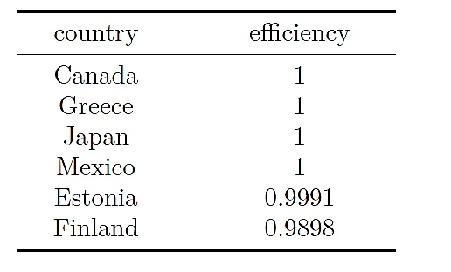
Results—Efficiency Scores

Slide 11
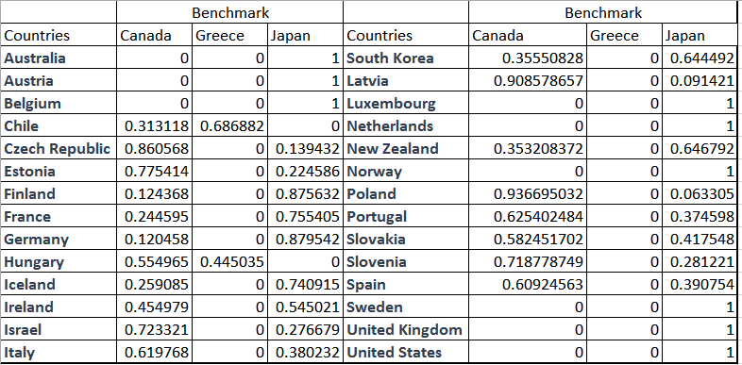
Results--Benchmarking

Slide 12
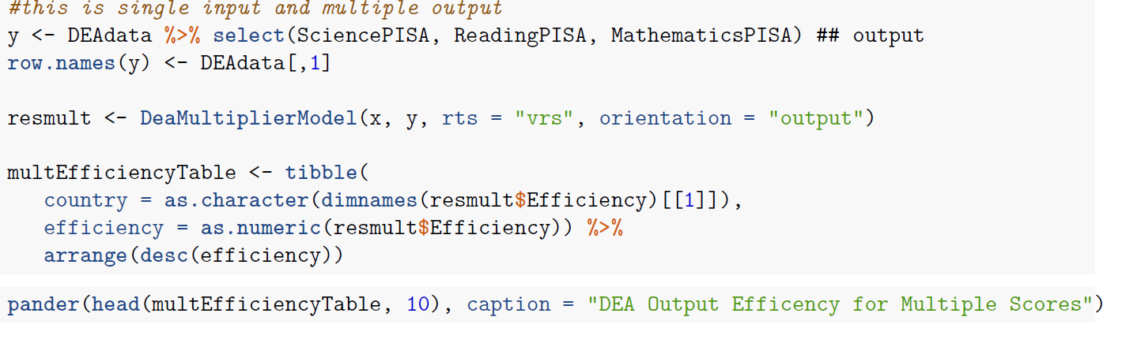
Multiple Output—Model Implementation

Slide 13
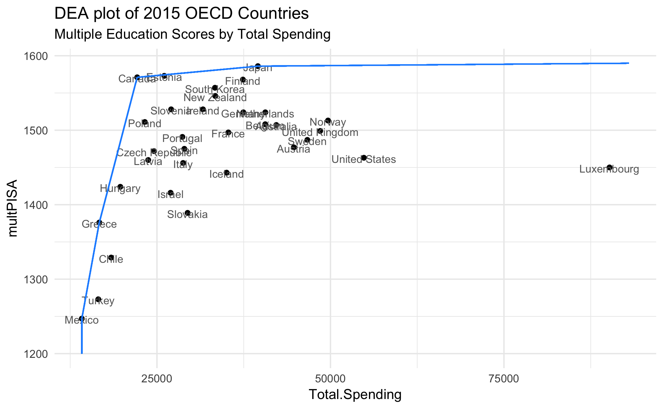
M.O Benchmark

Slide 14
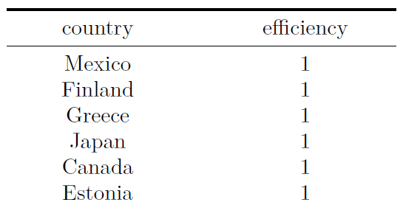
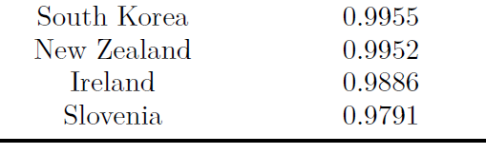
Multiple Outputs—Results (Efficiencies)

Slide 15
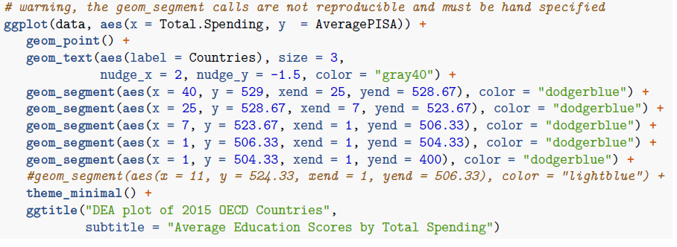
Previous graph was little convoluted, lets use ggplot

Slide 16
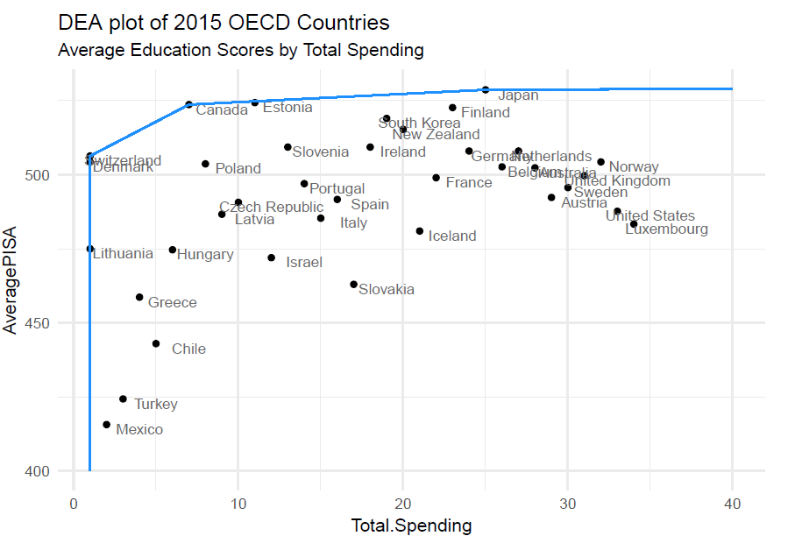

Slide 17
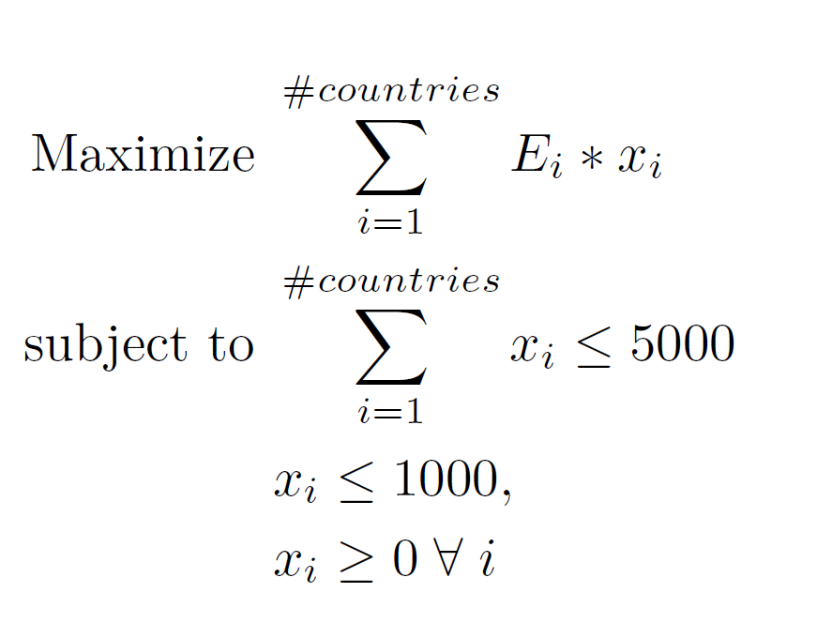
LP Model

Slide 18
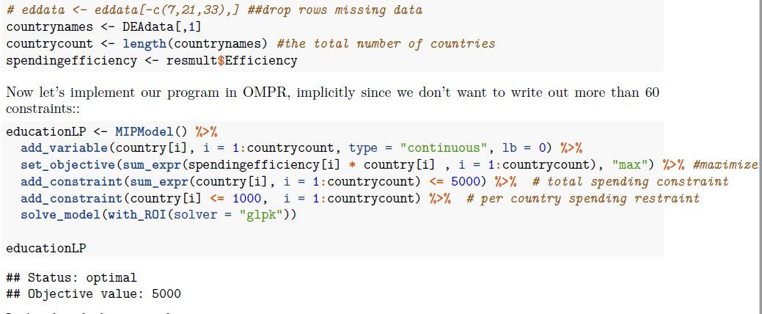
Implementing the model

Slide 19
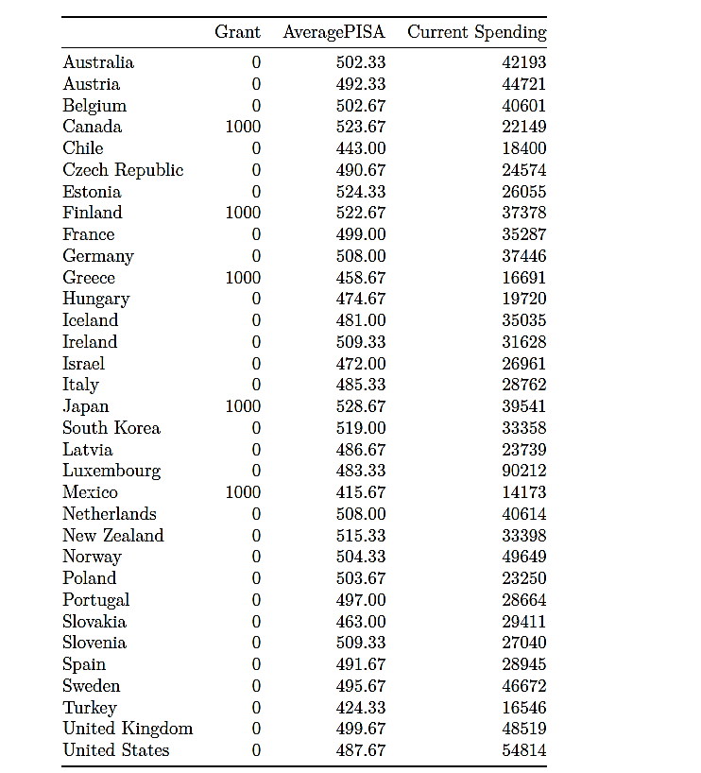

Slide 20
